Slide 1

The Impact of the COVID-19 Pandemic on Undergraduate Enrollment in the United States: A Quantitative Analysis
Presenter: Saikiran Reddy Salama
Date: 12/09/2024
Course: ADTA 5410 Applications & Deployment of Advanced Analytics

Slide 2
Abstract
Overview:
Study explores how the COVID-19 pandemic influenced undergraduate enrollment in the U.S. (2016 to 2022).
Focuses on trends before, during, and after the pandemic.
Uses regression analysis to analyze changes and identify state-level and institutional variations.

Slide 3
Research Objectives
Primary Goals:
Assess trends in undergraduate enrollment pre-pandemic, during the pandemic, and post-pandemic.
Analyze the pandemic’s impact using regression models.
Identify states and institutions most affected by enrollment changes.

Slide 4
Literature Review Highlights
Pre-Pandemic Trends:
Declining enrollments (NCES, 2023): 15% decrease from 2010 to 2021.
Pandemic Impact:
Accelerated enrollment decline due to health concerns, financial instability, and online learning transition.
Comparison with Past Recessions:
Unlike the 2008 recession, COVID-19 saw a decrease in enrollments due to unprecedented challenges

Slide 5
Data and Methodoloty
Data Description:
Undergraduate enrollment data (2016 to 2022).
Variables: Year, Institution Type, State, Enrollment Numbers.
Methodology:
Cleaned data by removing non-U.S. records and handling missing values.
Categorized data into pre-pandemic, pandemic, and post-pandemic periods.
Regression analysis used to identify trends and significant factors.

Slide 6
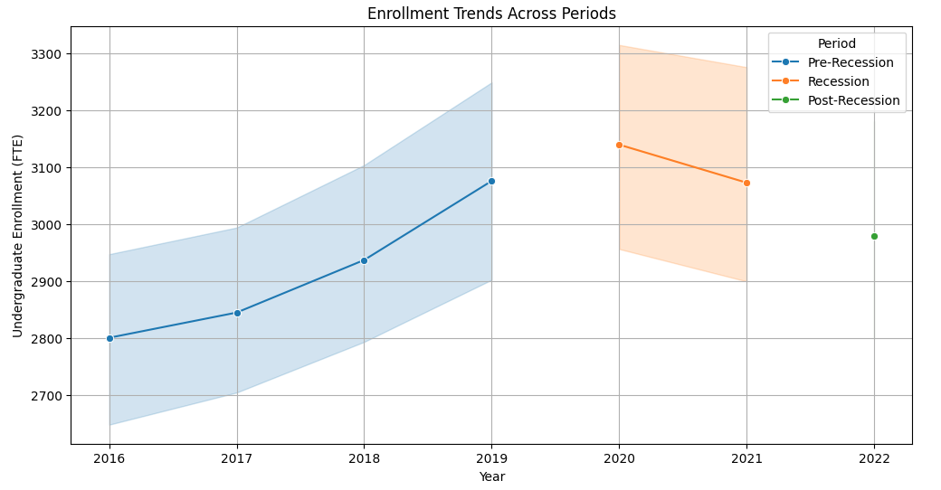
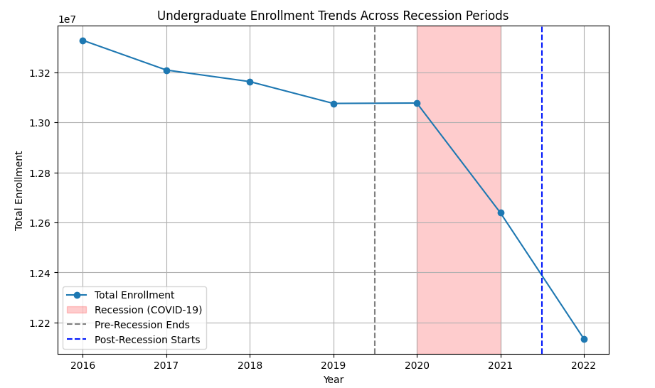
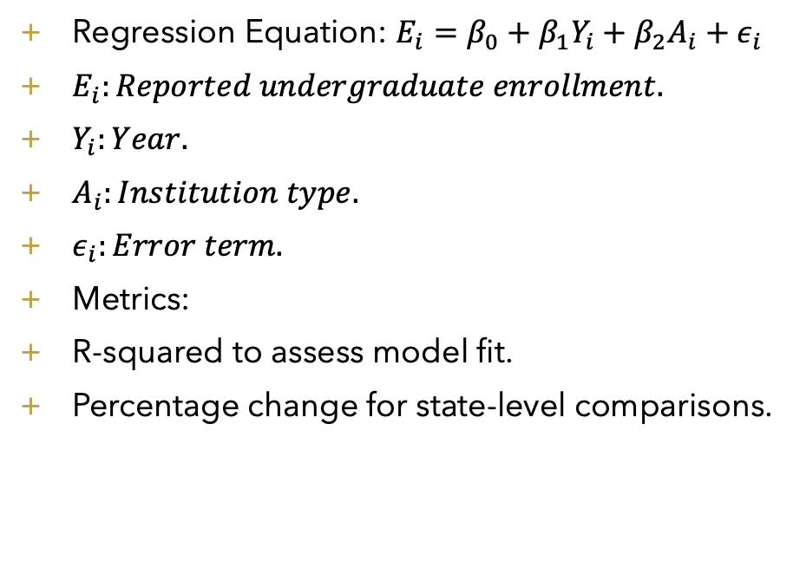
Statistical Models
Regression Equation: $E_{i}=β_{0}+β_{1}Y_{i}+β_{2}A_{i}+ε_{i}$
$E_{i}:Reported undergraduate enrollment.$
$Y_{i}:Year.$
$A_{i}:Institution type.$
$ε_{i}:Error term.$
Metrics:
R-squared to assess model fit.
Percentage change for state-level comparisons.

Slide 7
Results – Descriptive Statistics
Enrollment Averages:
Pre-pandemic (2016 to 2019): 2909.95 students.
Pandemic: (2020 to 2021): 3106.66 students.
Post-pandemic (2022): 2979.33 students.

Slide 8
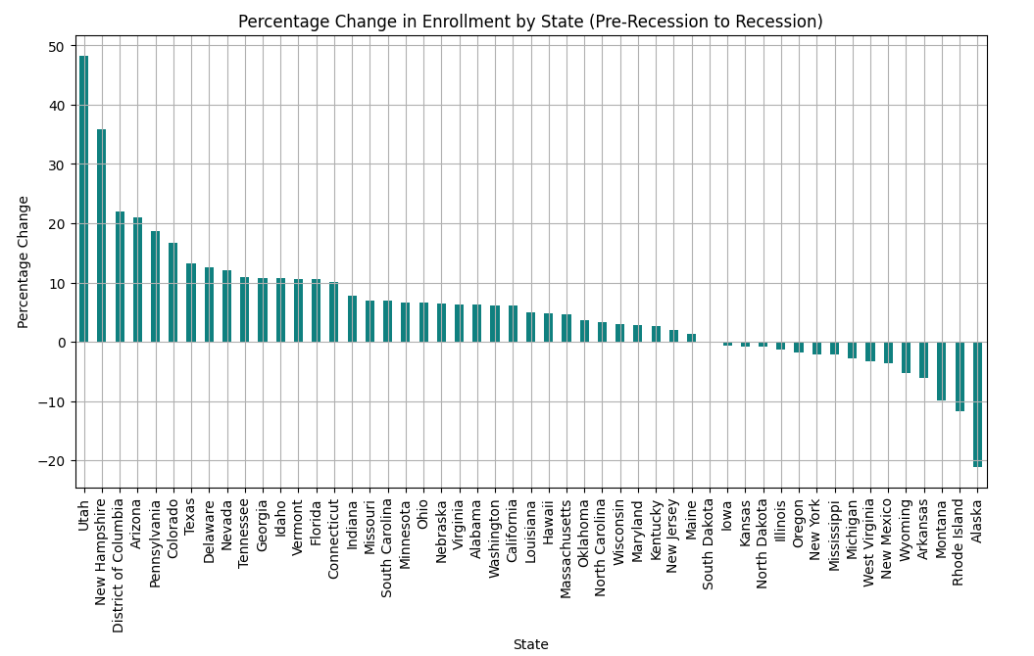
State-Level Analysis
States with Growth:
Utah (+52.56%), New Hampshire (+42.49%), District of Columbia (+24.62%), Arizona (+22.24%), Colorado (+17.20%).
States with Decline:
Alaska (-21.10%), Rhode Island (-11.73%), Arkansas (-9.83%), Wyoming (-6.12%), Montana (-5.83%).

Slide 9
Institutional Responses
Adaptations During the Pandemic:
Expanded admissions policies.
Increased financial aid for students.
Challenges:
Digital divide limited access to resources for some students. Resource disparities affected institutional responses.

Slide 10
Conclusion
Key Takeaways:
COVID-19 significantly impacted undergraduate enrollment, with variations across states and institutions.
Public institutions showed more resilience than private ones.
Enrollment declined more sharply post-pandemic than during the pandemic.
Future Research Recommendations:
Explore the long-term impact of online learning adoption.
Investigate demographic shifts influencing enrollment trends.

Slide 11
References
Hayoung Kim, C. K. (2020, May 21). COVID-19 and US higher education enrollment: Preparing leaders for fall. Retrieved from mckinsey.com: https://www.mckinsey.com/industries/education/our-insights/covid-19-and-us-higher-education-enrollment-preparing-leaders-for-fall
Howell, J., Hurwitz, M., Ma, J., Pender, M., Perfetto, G., & Young, L. (2021). College Enrollment and Retention in the Era of Covid. CollegeBoard.
Jingyun Li, J. M. (2019, February). College and University Professional Association for Human Resources. Retrieved from https://www.cupahr.org/: https://www.cupahr.org/surveys/research-briefs/2018-impact-of-the-economic-recession/?utm_source=chatgpt.com
NCES. (2023, May). Retrieved from nces.ed.gov: https://nces.ed.gov/programs/coe/indicator/cha?utm_source
NCES. (n.d.). Annual Reports and Information Staff (Annual Reports). Retrieved from nces.ed.gov: https://nces.ed.gov/surveys/annualreports/topical-studies/covid/?utm_source
NSC Blog. (2020, April 15). How Will the Next Recession Impact U.S. College Enrollment, Persistence and Completions? Retrieved from https://www.studentclearinghouse.org/: https://www.studentclearinghouse.org/nscblog/how-will-the-next-recession-impact-u-s-college-enrollment-persistence-and-completions/

